Slide 1


GAME UP
Taking back the gaming industry by connecting gamers to publishers
Group 2
Chenyi Xu
Royal Nebeker
Sahira Zaheen
Wei Lin

Slide 2

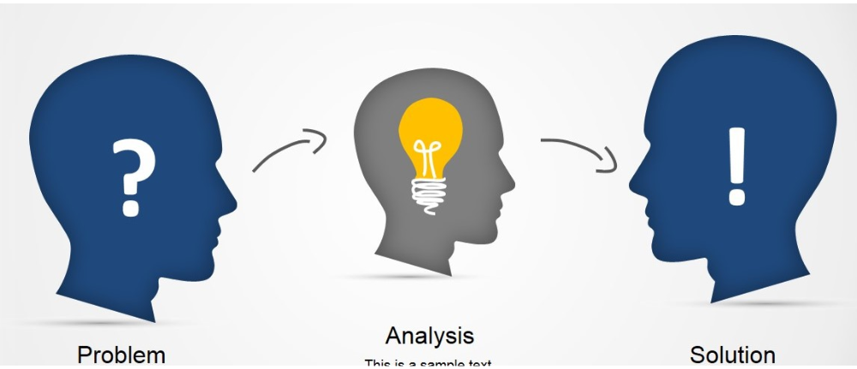
Problem
Massive marketing budgets drowning out small publishers
Reviews are purchased and paid for
The same franchise repeatedly
· Innovation is lacking

Slide 3

Mission
“Taking back the gaming industry by connecting gamers to publishers from every corner of the world using honest gamer-generated information to unlock all achievements.”
Maintaining Review Integrity
Equal rating policy for games
across big & small publishers
and games
Review
Integrity
Of
Review
Internet
Usage
Estimate of Internet-use
Plan ahead and improve cost estimates for downloading the game using internet
Rating
Game
Size
Genre
Easily found genre
Search favourite genre and find games from small to big publishers from all over the world

Slide 4
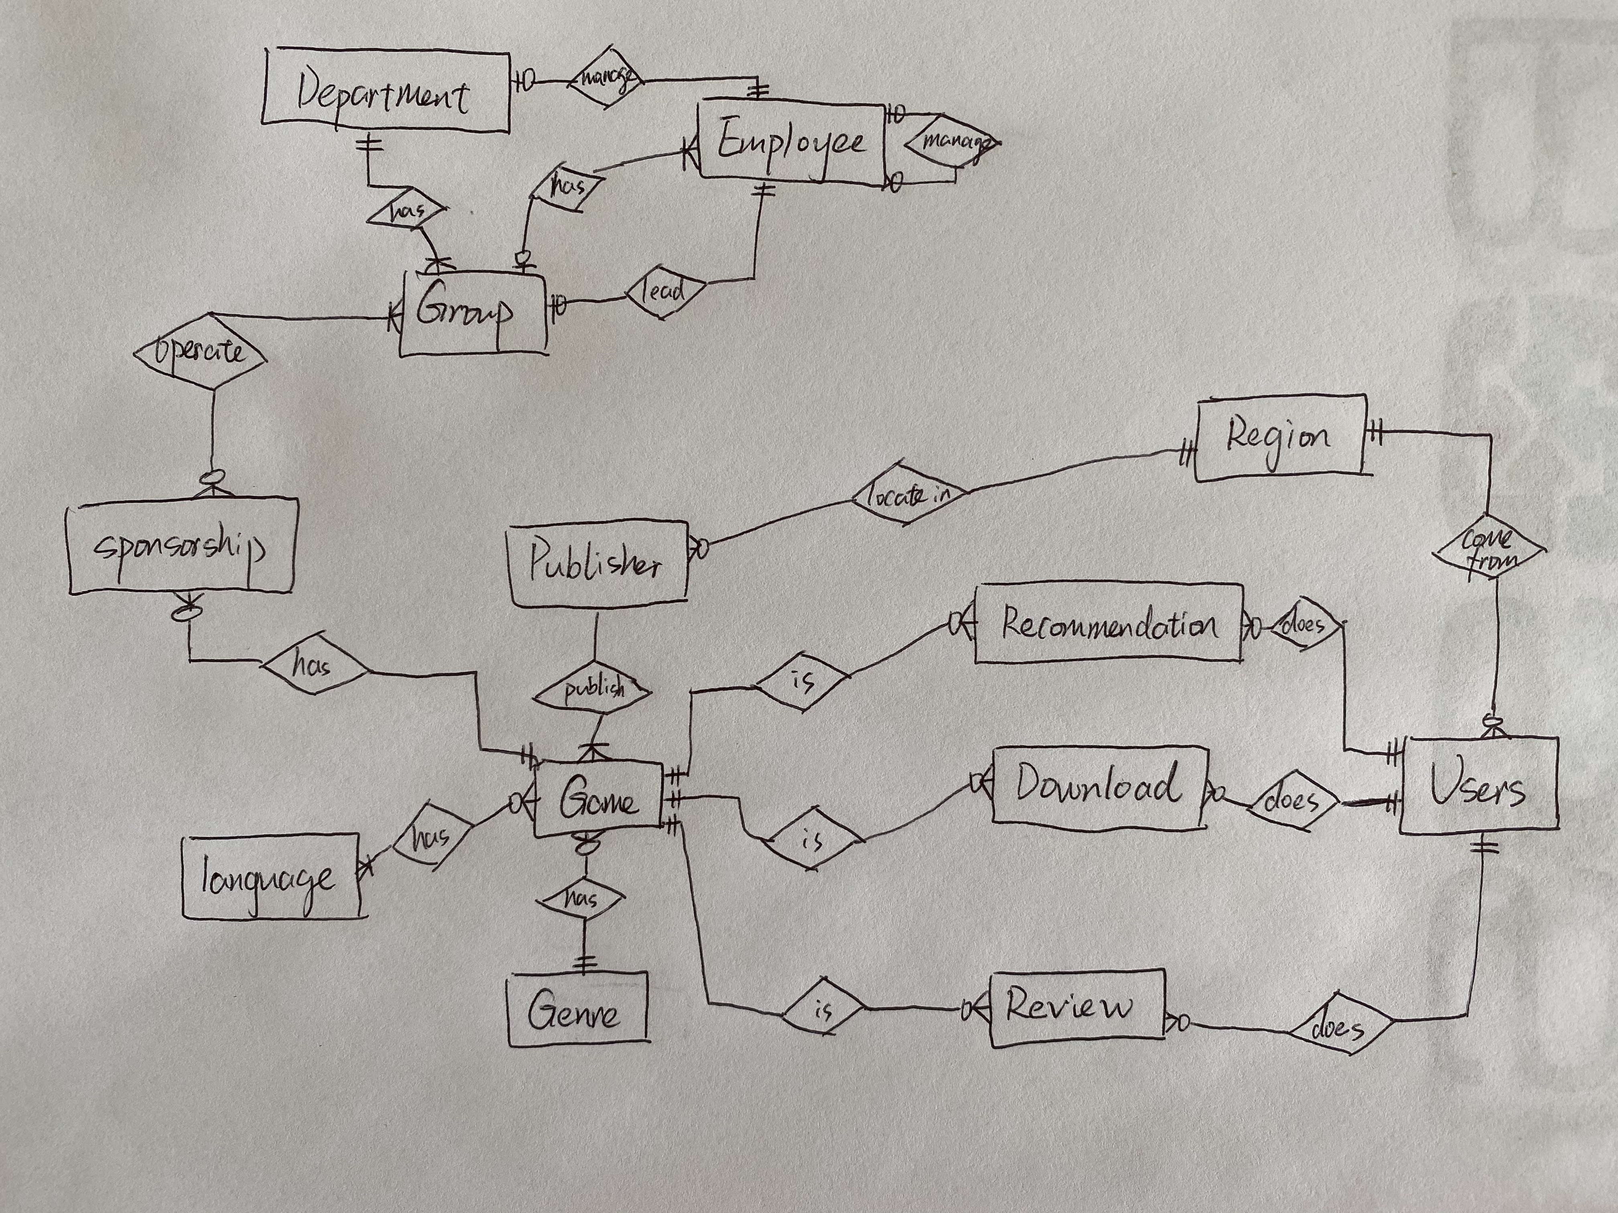
Conceptual Diagram
Notes:
fact_<Revenue Fact Table>
This Revenue Fact Table records the download count, revenue(sum of publisher_charged_money) and plarform for each game, user and day. It has three primary keys and four foreign keys referencing seven dimension tables, Calendar Dimension, Game Dimension, User Dimension, Region Dimension, Genre Dimension, Sponsorship Dimension and Department_group Dimension.
For calendar dimension table, extract the download_date from download table and then transfer it to fill in the information of date, like day of week, day of month, month, quarter and year.
For game dimension table, extract the information of game name, rating and size from game table and join with publisher table to get game and publisher information.
For user dimension table, extract the information of user name, email, birth date and first_registration_date in user table to get user information.
For region dimension table, extract the information of region id and name in region table.
For genre dimension table, extract the information of genre id and name in region table.
For sponsorship dimension table, extract the information of sponsorship type and money and its start date and end date from sponsorship table.
For department_group dimension table, join group table and department table and employee table to get the department name, group name and employee information.

Slide 5

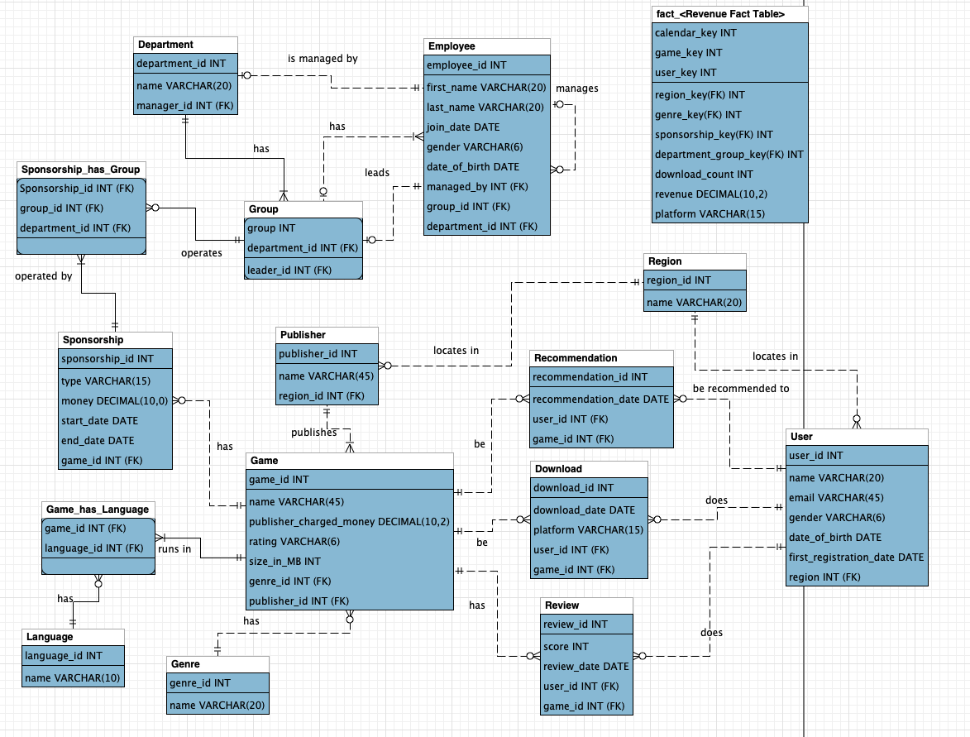



Physical Diagram
Revenue Fact Table
Sponsorship related tables
Game related tables
User related tables
Notes:
fact_<Revenue Fact Table>
This Revenue Fact Table records the download count, revenue(sum of publisher_charged_money) and plarform for each game, user and day. It has three primary keys and four foreign keys referencing seven dimension tables, Calendar Dimension, Game Dimension, User Dimension, Region Dimension, Genre Dimension, Sponsorship Dimension and Department_group Dimension.
For calendar dimension table, extract the download_date from download table and then transfer it to fill in the information of date, like day of week, day of month, month, quarter and year.
For game dimension table, extract the information of game name, rating and size from game table and join with publisher table to get game and publisher information.
For user dimension table, extract the information of user name, email, birth date and first_registration_date in user table to get user information.
For region dimension table, extract the information of region id and name in region table.
For genre dimension table, extract the information of genre id and name in region table.
For sponsorship dimension table, extract the information of sponsorship type and money and its start date and end date from sponsorship table.
For department_group dimension table, join group table and department table and employee table to get the department name, group name and employee information.

Slide 6
Business Rules
Sponsorship
Publishers can sponsor in one or many ways, i.e., financial sponsorship, media sponsorship, event sponsorship, etc. Groups that handle sponsorship can only access the information about sponsorship.
Users
Users have to sign in for a user account and cannot have more than one account with one email ID.
Review
Review is an integral part of this database as its purpose is to facilitate users with their desired games regardless of popularity. As such, securing integrity of reviews is the main goal, therefore, users cannot review a game more than once.
Notes:
fact_<Revenue Fact Table>
This Revenue Fact Table records the download count, revenue(sum of publisher_charged_money) and plarform for each game, user and day. It has three primary keys and four foreign keys referencing seven dimension tables, Calendar Dimension, Game Dimension, User Dimension, Region Dimension, Genre Dimension, Sponsorship Dimension and Department_group Dimension.
For calendar dimension table, extract the download_date from download table and then transfer it to fill in the information of date, like day of week, day of month, month, quarter and year.
For game dimension table, extract the information of game name, rating and size from game table and join with publisher table to get game and publisher information.
For user dimension table, extract the information of user name, email, birth date and first_registration_date in user table to get user information.
For region dimension table, extract the information of region id and name in region table.
For genre dimension table, extract the information of genre id and name in region table.
For sponsorship dimension table, extract the information of sponsorship type and money and its start date and end date from sponsorship table.
For department_group dimension table, join group table and department table and employee table to get the department name, group name and employee information.

Slide 7
Business Rules
Recommendation
Recommendations will be sent to users according to their search and download history. Recommendation (similar genre’s game) sending time cannot precede user’s download time.
Invoices
Invoices are billed to a publisher only after the related games are downloaded by the user​. Invoices are sent on a weekly basis.
Employees
Employees may be assigned to groups/teams in one department. However, they may not work in more than two groups and cannot be managed by more than two managers.
Notes:
fact_<Revenue Fact Table>
This Revenue Fact Table records the download count, revenue(sum of publisher_charged_money) and plarform for each game, user and day. It has three primary keys and four foreign keys referencing seven dimension tables, Calendar Dimension, Game Dimension, User Dimension, Region Dimension, Genre Dimension, Sponsorship Dimension and Department_group Dimension.
For calendar dimension table, extract the download_date from download table and then transfer it to fill in the information of date, like day of week, day of month, month, quarter and year.
For game dimension table, extract the information of game name, rating and size from game table and join with publisher table to get game and publisher information.
For user dimension table, extract the information of user name, email, birth date and first_registration_date in user table to get user information.
For region dimension table, extract the information of region id and name in region table.
For genre dimension table, extract the information of genre id and name in region table.
For sponsorship dimension table, extract the information of sponsorship type and money and its start date and end date from sponsorship table.
For department_group dimension table, join group table and department table and employee table to get the department name, group name and employee information.

Slide 8
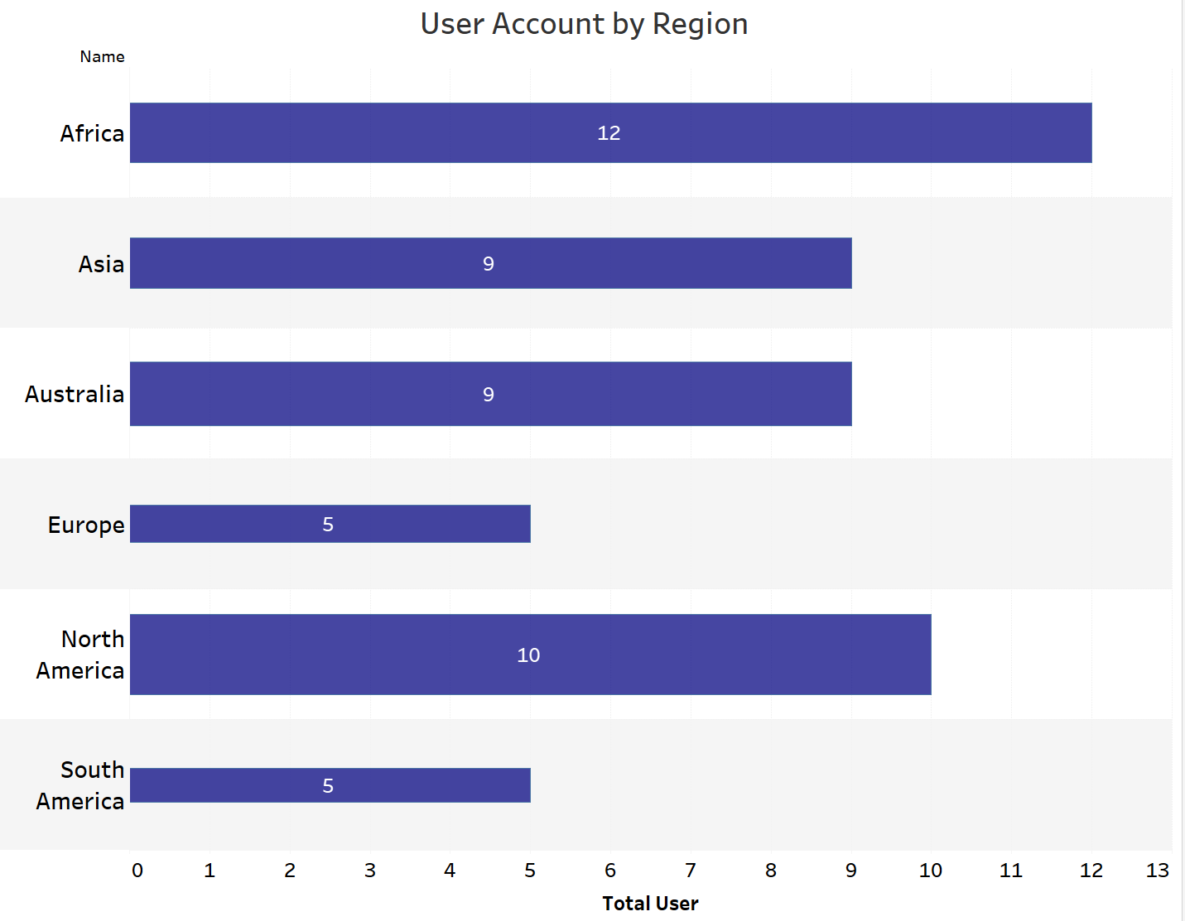
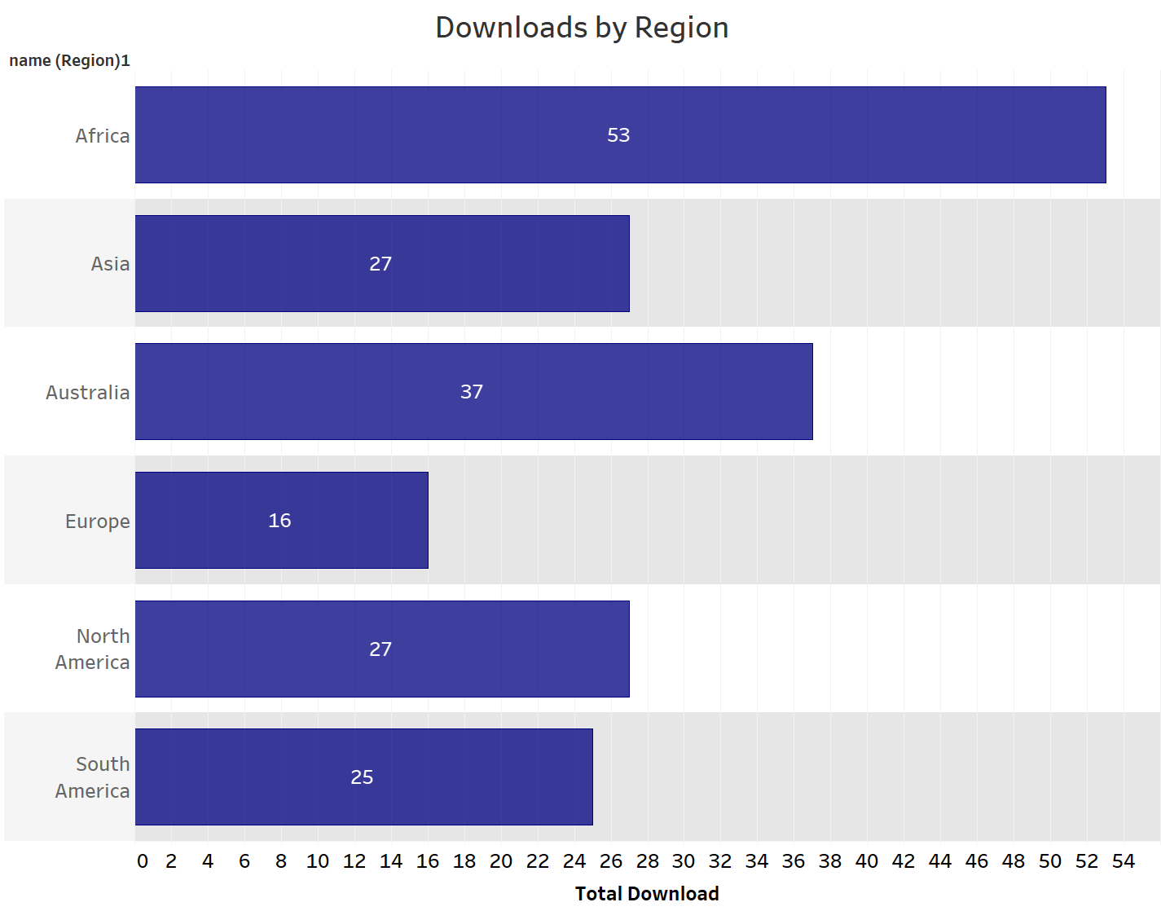
Analytical Query
The purpose of this query is to create a view that displays the total number of users by region. Employees can use this information to better plan their strategy around the regions.
After getting the information about total users account, knowing the activation/total download from the accounts will be necessitated to better analyze the actual turn out

Slide 9
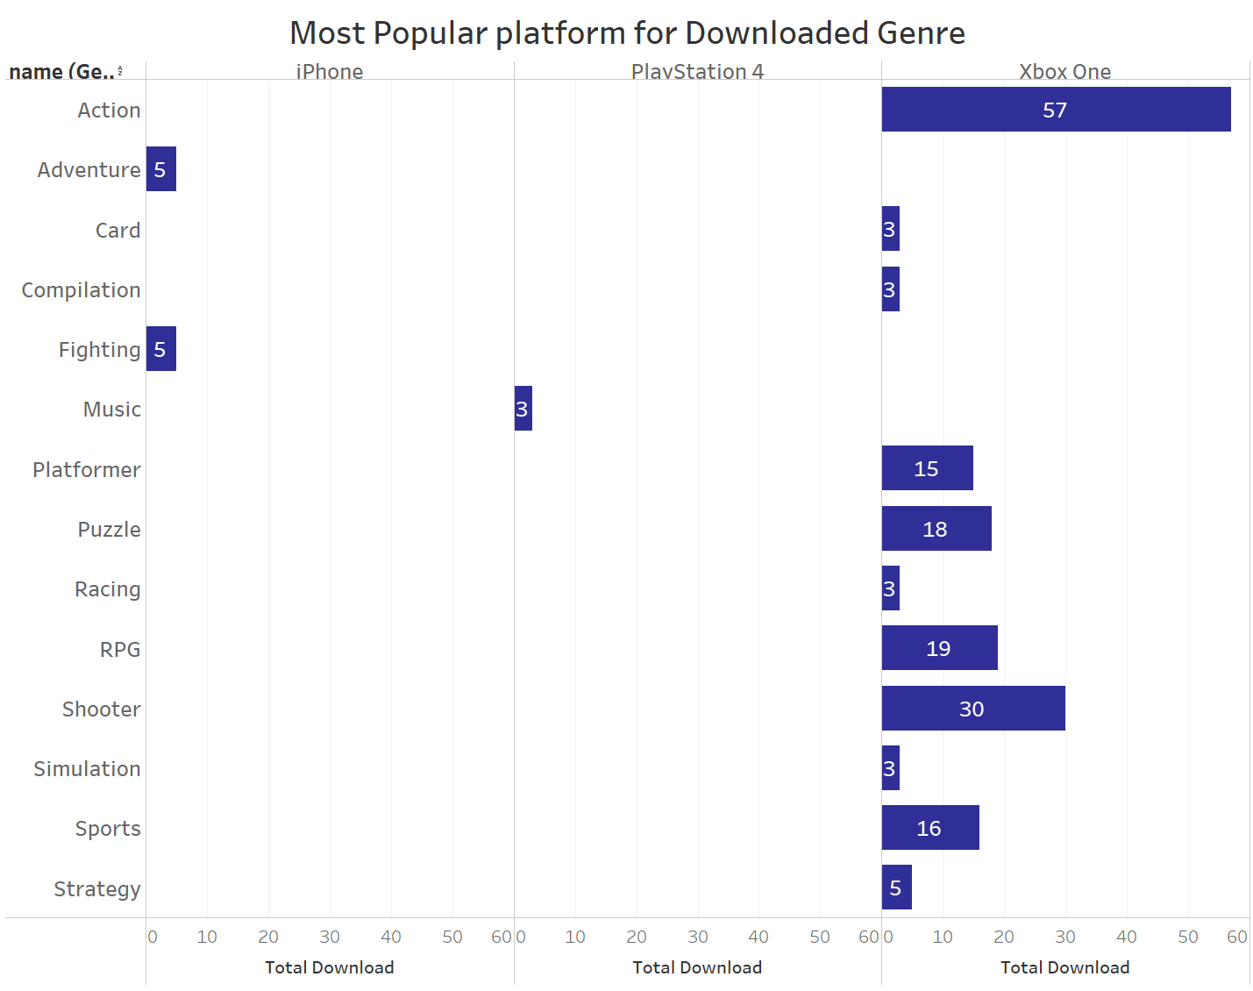
Market Analysis
After finding out the numbers, the next step is to get the facts behind those numbers
i.e. which platform is most popular for each genre.

Slide 10
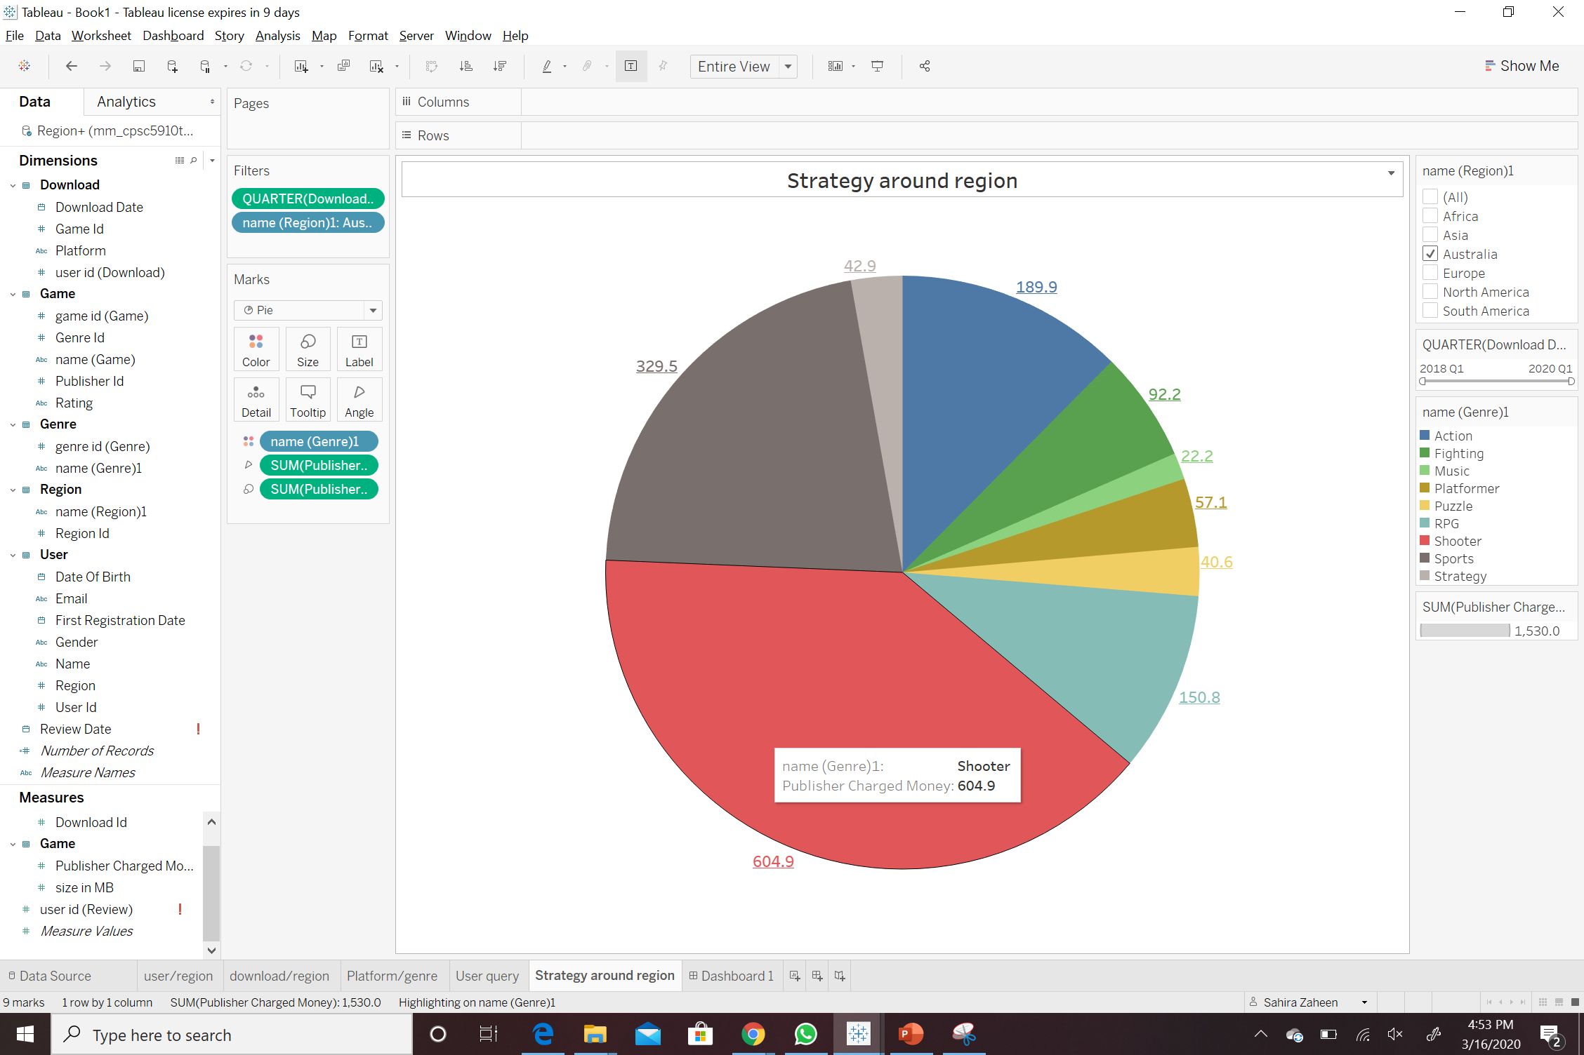
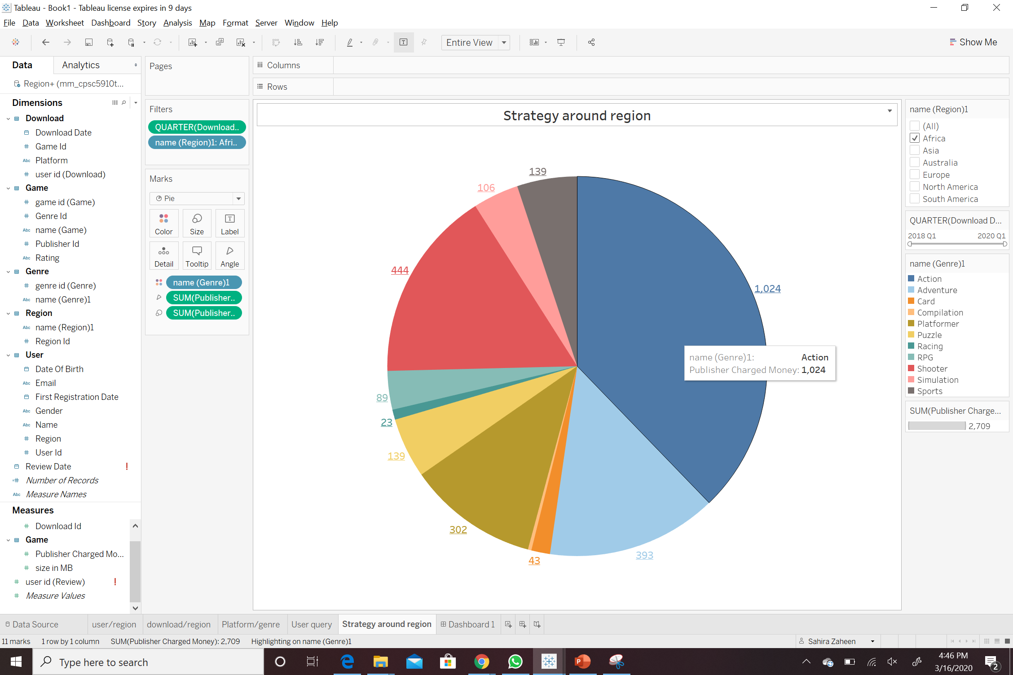
Sales Analysis Query
Marketing analysts can look into each region and find out which genre is more profitable to do better marketing strategy
i.e. action is more profitable in Africa whereas in Australia, shooter is more profitable

Slide 11
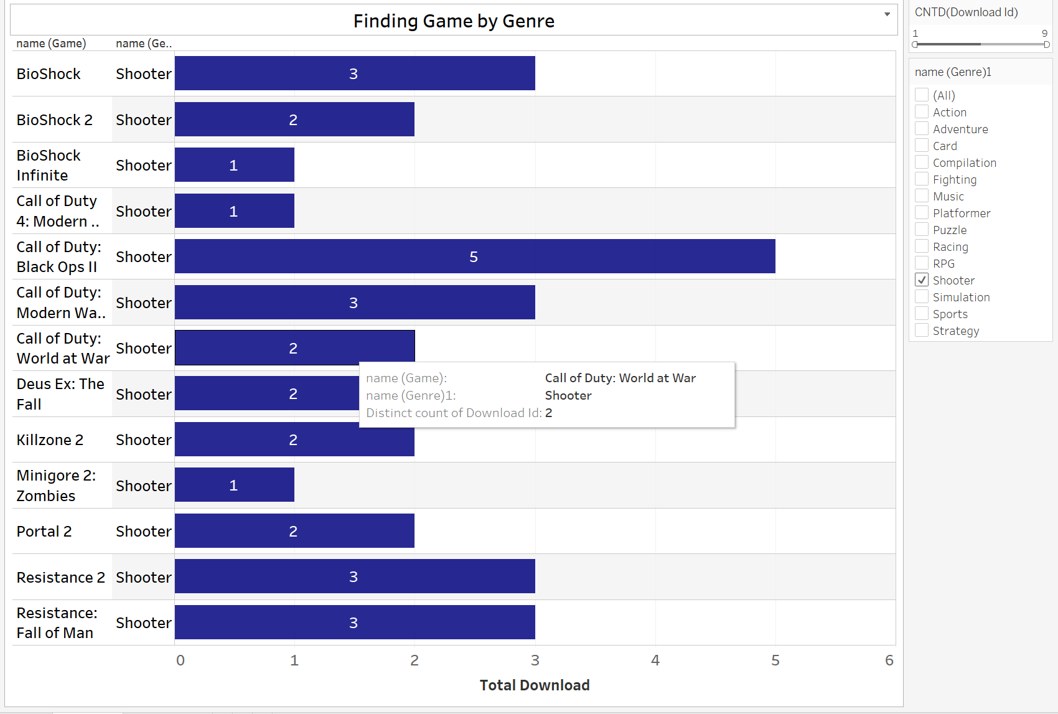
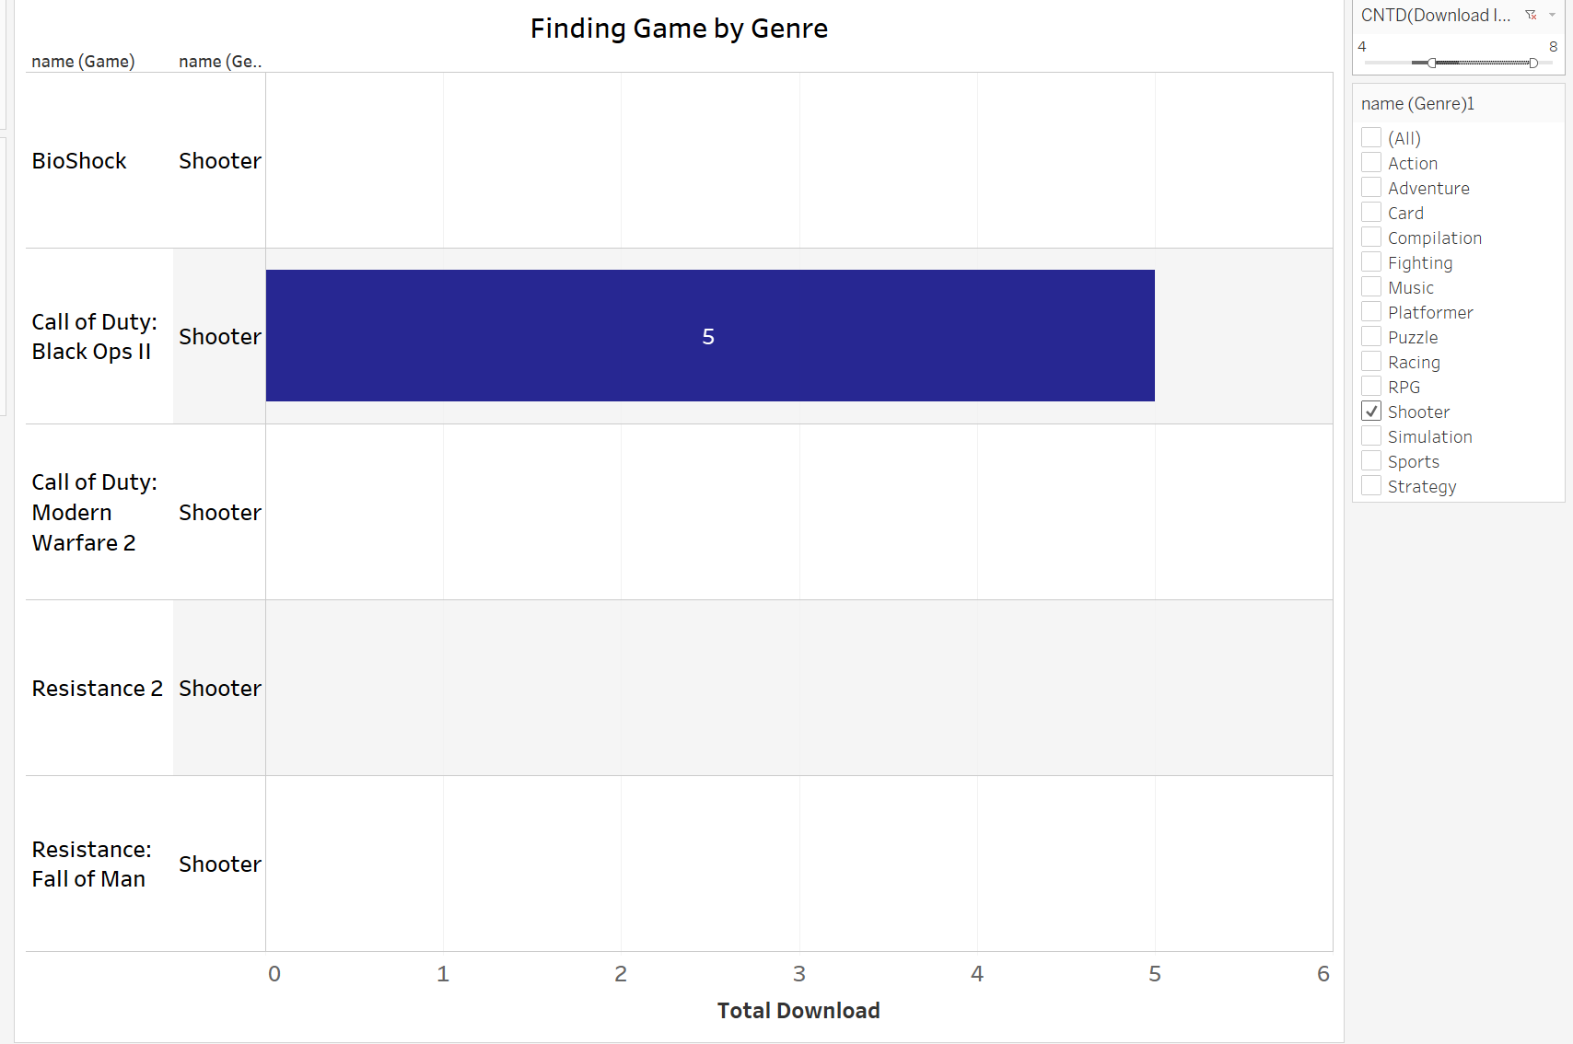
Query for Users
Users can search for games by their desired genre and also with the download counts to see which game has been downloaded most
i.e. users can select fighting from genre and will get the names that have been popular/downloaded before

